Slide 1
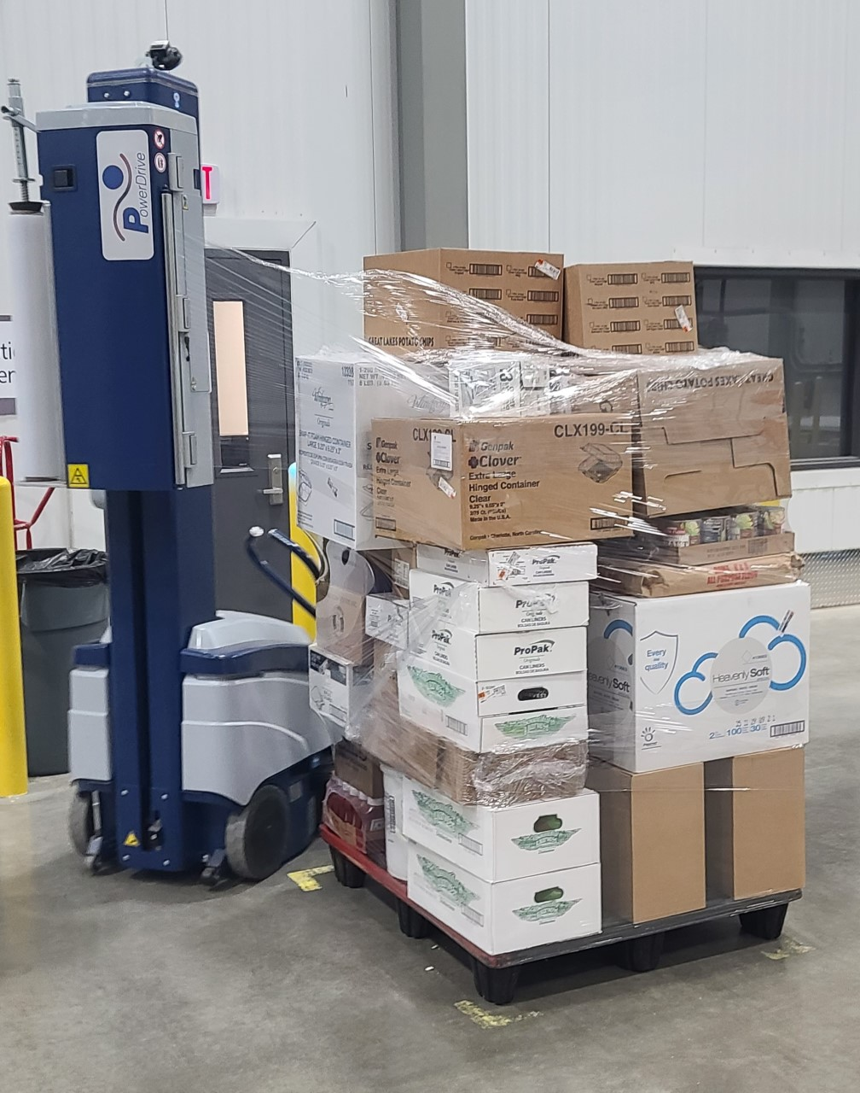
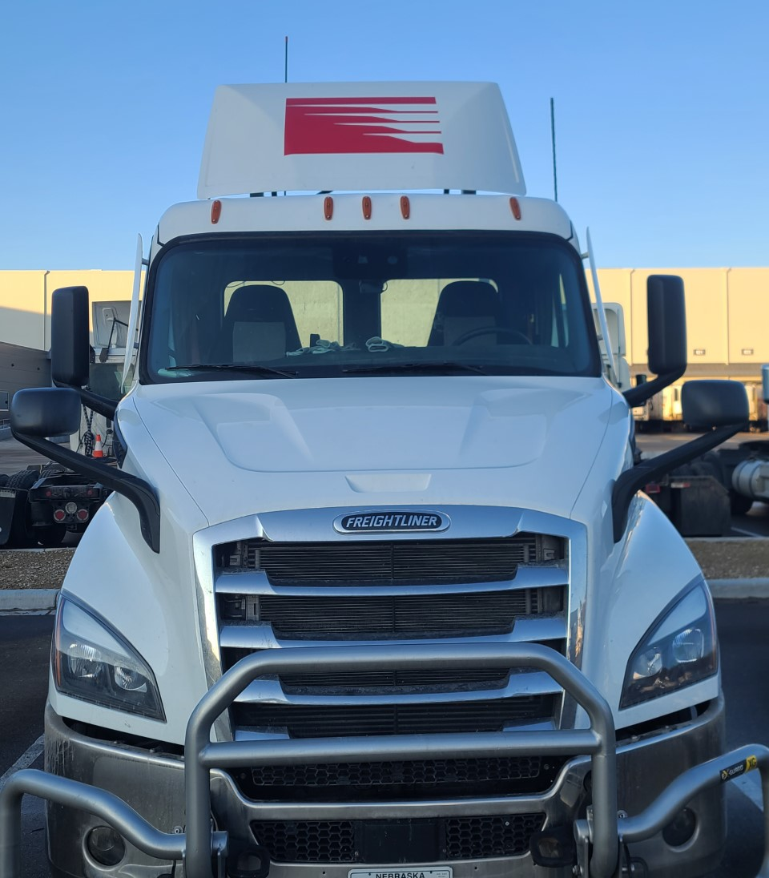
APPLY NOW
SUMMER POSITIONS AVAILABLE
$500 BONUS
JOB REQUIREMENTS INCLUDE
Must be 18 years of age with high school diploma or equivalent preferred
Must be able to lift 50 pounds frequently and up to 80 pounds occasionally
Must be able to work independently with little supervision
DRIVER HELPER
Earn $19 per hour as a Driver Helper!
This position is a gateway to a career as a Professional CDL driver. Driver Helpers are a part of the delivery process with Class A and Class B drivers, and unload product using a 2-wheel cart off the trailer into customer locations.
SCHEDULE
Monday – Friday
LEAVE TIME VARIES 1- 5 AM
10 – 12 hr shifts
ORDER SELECTOR
Position starts at $19 per hour with performance-based pay after training averaging $21 - $23 per hour. Duties include accurately selecting product to match picking labels, palletizing the product, and preparing product for shipping. Join our winning team!
Little to no experience needed!
SCHEDULE
Sunday Night – Thursday Night
START TIME is 4 pm
8–10-hour shifts
Finish Time varies
WEEKENDS OFF!
FRIDAY & SAT
OFF!!
After completing 10 full weeks during the summer, you will receive a $500 sign-on bonus
APPLY TODAY!
IN PERSON AT 1260 COUNTY ROAD B SHAWANO, WI 54166
ONLINE AT JOBS.PERFORMANCEFOODSERVICE.COM
QUESTIONS? CALL 1.800.827.4035 AND PRESS 5 FOR HR

